Slide 1
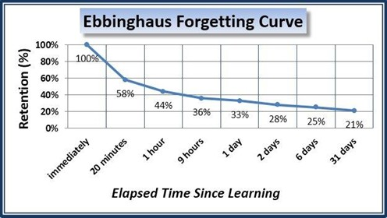
Think about….
What is this graph?
What do you already know about it?

Slide 2


Retrieval practice and spaced practice
#beingthebestyoucanbe

Slide 3
Why is it important to revise effectively?
How can I revise effectively?
Revising ineffectively is a waste of time.
To help you to make progress.
To help you to be the best you can be.
To reduce the stress and anxiety associated with exams and studying.
To make you a better, more effective learner and deepen knowledge.
Use retrieval practice regularly outside of lessons.
Engage fully with the retrieval practice your teachers are using in lessons/homework.
Use spaced practice to ensure you are recalling information regularly and strengthening memory.

Slide 4

Retrieval Practice
PRACTICE BRINGING INFORMATION TO MIND
WHY?
Helps to strengthen our memory for information we have learnt. (Deepen learning).
Makes us better able to apply our learning to new situations.
Forgetting is less likely to occur – beat the forgetting curve.
HOW?
Flashcards/Quizlet of key words after each lesson
Practice exam questions
Text book questions
Test friends

Slide 5
Spaced Practice
SPACE OUT YOUR STUDYING OVER TIME
WHY?
Research has consistently shown that five hours studying spread out over two years is better than studying for five hours in one go (cramming).
Produces long-lasting learning (beat forgetting curve) and less is forgotten.
Good for linear exams – sat after 2/3 years of study.
Reduces stress and anxiety before exams.
HOW?
Get into the habit of studying each day.
Allow a bit of time to forget then recall information learnt e.g. keywords.
Flashcards, free recall, quizzing, sketching, retrieval practice. DON’T JUST READ NOTES!!!

Slide 6

Why are teachers asking me to use green pen and do lots of quizzes?

Slide 7
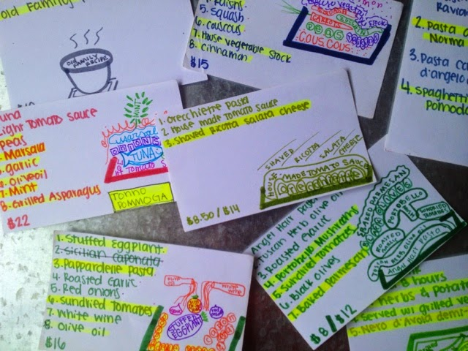

Working with my teachers…
Use green pen to identify your weak areas – identify WHAT you need to revise.
  E.g. In French – make flashcards out of the words you didn’t know, written in green.
  In History – write from memory the points you had to add during DIRT.
Try your best to recall information from previous years in class quizzes.
Use homework quizzes to improve learning – three attempts, revise after each one, aim for 100%.

Slide 8

